Slide 1
Spark with python
Machine learning with pyspark

Slide 2
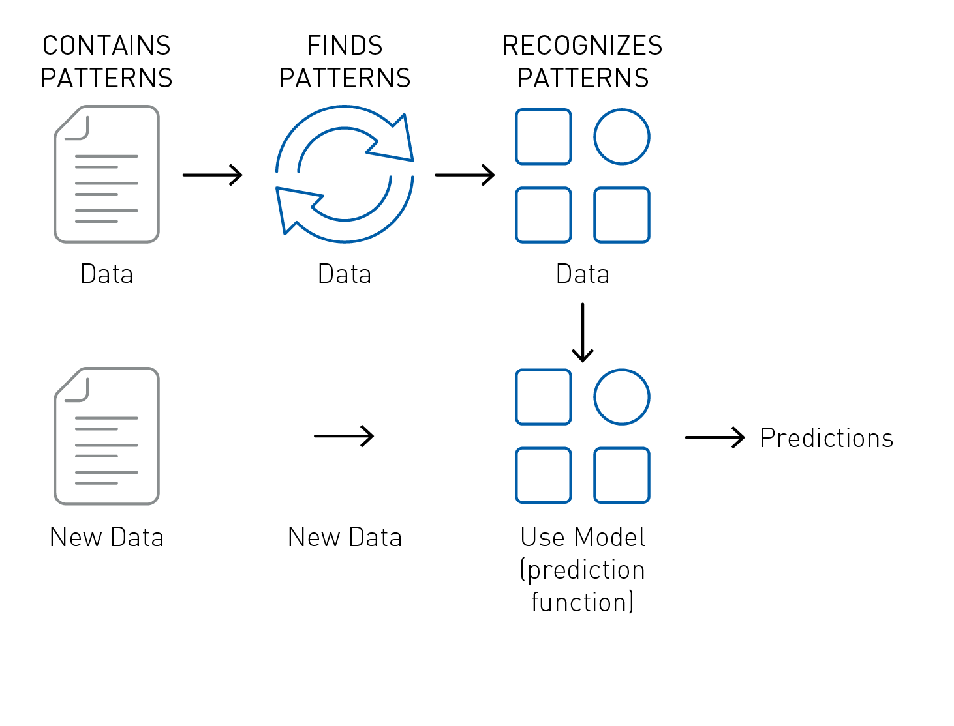
What is machine learning

Slide 3
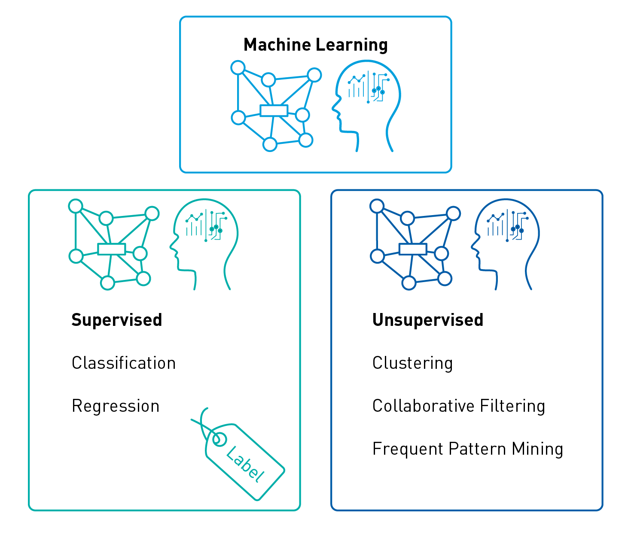
Types of machine learning

Slide 4
